Slide 1
Archiving occultation light curves
Dave Herald
Murrumbateman

Slide 2
Occultation light curves now on VizieR !!!
VizieR catalogue: B/occ
Can query using Star ID, observer name, and more…
Can plot, by clicking the LCxxx Seq no.
1671 light curves, soon to exceed 2000.
All observers are encouraged to submit light curves for archiving!

Slide 3
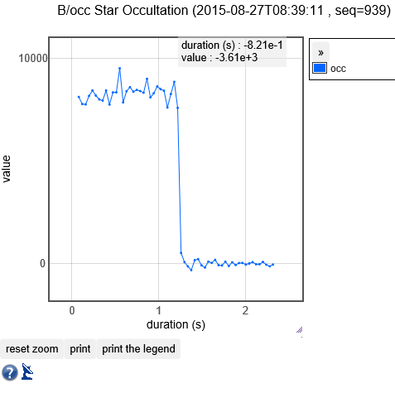
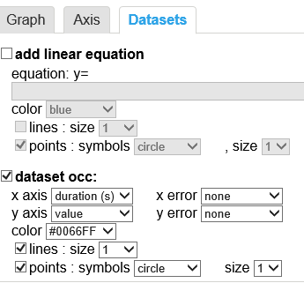
Example VizieR plot & options

Slide 4
Essential premise
A video recording at 30fps will easily attain an angular resolution of 0.01” in a lunar occultation,
this is a factor of at least 50 greater than resolution provided by normal telescopes subject to the Earth’s atmosphere; even better than Gaia
∴ Video recording lunar occultations provides a tool for surveying the size &/or presence of companions at a resolution of ~0.01”, in an 11° band centred on the ecliptic,

Slide 5
Some history
Prior to ~2000, almost all occultation observations were made visually
The objective was to determine the time of the event – and nothing else
Lunar occultations: measure the irregularity in the Earth’s rotation
Asteroidal occultations: measure the size and shape of asteroids

Slide 6
Some history (2)
high speed photoelectric observations of lunar occultations have been made since the 60’s. Number is small, and used large telescopes
Discovered double stars, measured stellar diameters (and light distribution across large stars such as Aldebaran & Antares), and had to deal with Fresnel diffraction

Slide 7
Some history (3)
Amateurs started using video from about 2000
For many years, video analysed visually via video playback
Some (most notably in Europe) converted individual frames into FITS files, and used ‘traditional’ CCD imaging tools to conduct a photometric measure of the star over a series of FITS files
But focus remained on establishing the event time, and not on the light curve per se

Slide 8
Some history (4)
~2005 – Limovie - the first tool that enabled simple but reliable measurement of a video
KIWI-OSD – a device to reliably insert a GPS-based time stamp on videos
Tangra – a second tool for measuring video – focussed primarily on asteroidal events
IOTA-VTI – a replacement for the KIWI-OSD (which had been withdrawn from sale)

Slide 9
Some history (5)
By 2010, video recoding of occultations, using a time inserter, had become the norm
Occasionally people noted steps in their light curves as measured by Limovie or Tangra
A system was developed to report and analyse double stars measured or discovered in this way
However many stars previously reported as double by visual observers did not display step events on a video measurement. Many showed gradual events, consistent with either Fresnel diffraction or stellar diameter

Slide 10
Some history (6)
An important issue with double star observations is to be able to combine multiple measurements to derive a solution for the PA and separation
There have been several instances where an ‘old’ video recording of a lunar occultation has been measured using modern tools – with the light curve showing a step event

Slide 11
Some history (7)
Recently the Kepler mission came to an end due to the failure of gyroscopes required for pointing the satellite
However it was determine that the satellite could observe areas of the sky along the ecliptic for about 3 months at a time – using the two remaining gyroscopes in combination with the solar wind
This mission is called K2
A researcher involved with K2 noted that occultation light curves of target stars could be very useful when analysing the K2 results

Slide 12
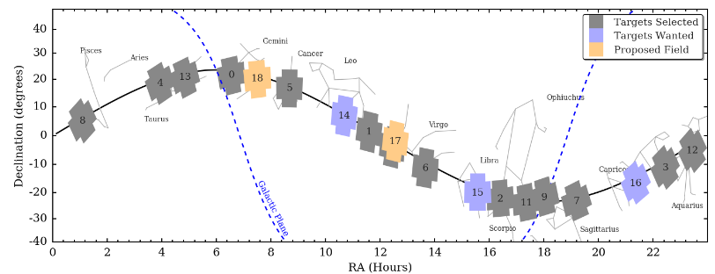
K2 fields
The fields observed by K2 continue to expand – but are all located along the ecliptic

Slide 13
Basic principle
To maximise the value of the video observations we make, we need to archive the light curves we record
Archiving makes the light curves available to all for future investigations
Remember that a light curve that does not show a companion is not proof the star is singular. It may have a companion in an elliptic orbit, and a light curve that does not show a companion may still be useful when determining the orbit

Slide 14
Archiving at VizieR
VizieR are keen & supportive of us archiving light curves with them
VizieR have assisted in developing a format for submitting light curve observations to them
Process for reporting observations has been made as simple as possible. I hope!...
Limovie has been updated to facilitate transferring light curve data to Occult (Tangra already had the required capability)

Slide 15
Reporting a light curve - Lunar
Enter the observation into the OCCULT Lunar Observations editor, in the usual fashion
After the observation has been entered, make sure the observation entry is highlighted in the Events screen – then click the menu item

Slide 16
Reporting a light curve – Lunar (2)
Occult generates all the information required to support the observation
All you need to do is copy the light curve as a CSV file from Limovie or Tangra, and paste into the report.

Slide 17
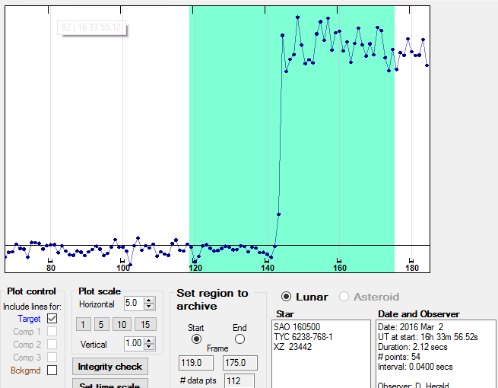
Reporting a light curve – Lunar (3)
Select the start and end of the segment of the light curve to be reported

Slide 18
Reporting a light curve – Lunar (4)
Click Save this report to save on your PC
Periodically, click Email multiple saved reports to submit them. Occult will periodically remind you.
Default reminder interval is one month

Slide 19
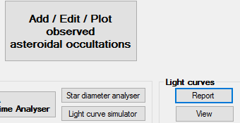
Reporting a light curve – Asteroids
From Asteroid Observations tab, click Light curves – Report
This will open the Light Curve report form, with some changes specific to asteroids.

Slide 20
Reporting a light curve – Asteroids 2
First step – Paste (or open) the light curve report
Second step – click
and then enter the details.

Slide 21
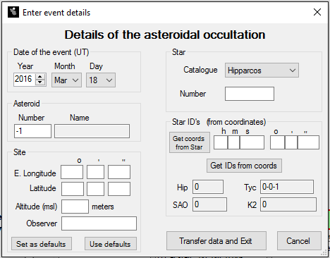
Site details can be set as default values
Click Get coords from Star to retrieve equivalents
Click Transfer data and Exit when done

Slide 22
Reporting a light curve – Asteroids 3
Select the start and end of the segment of the light curve to be reported – as per lunar occs. However the light curve will usually be much longer
Save as per lunar occs. The light curve will be saved in the same location as lunar light curves
Submit in same manner as for lunar light curves

Slide 23
Viewing light curves
The light curves are a download in Occult
Light curves can be viewed by star number
In Lunar occultation predictions – stars with a light curve available are flagged. The light curves can be viewed via the right-click menu
Currently, over 1,600 light curves available. Soon to be >2000.

Slide 24
Any questions?

